Slide 1

GDP CHANGE IN SWING STATES
Ethan Goldbeck, Priyanka Khanal, Madison Moye, Bhanuprasad Tudy and Yuxiang Wang
Notes:
Madison

Slide 2

The 2016 Presidential Election
Notes:
Madison

Slide 3
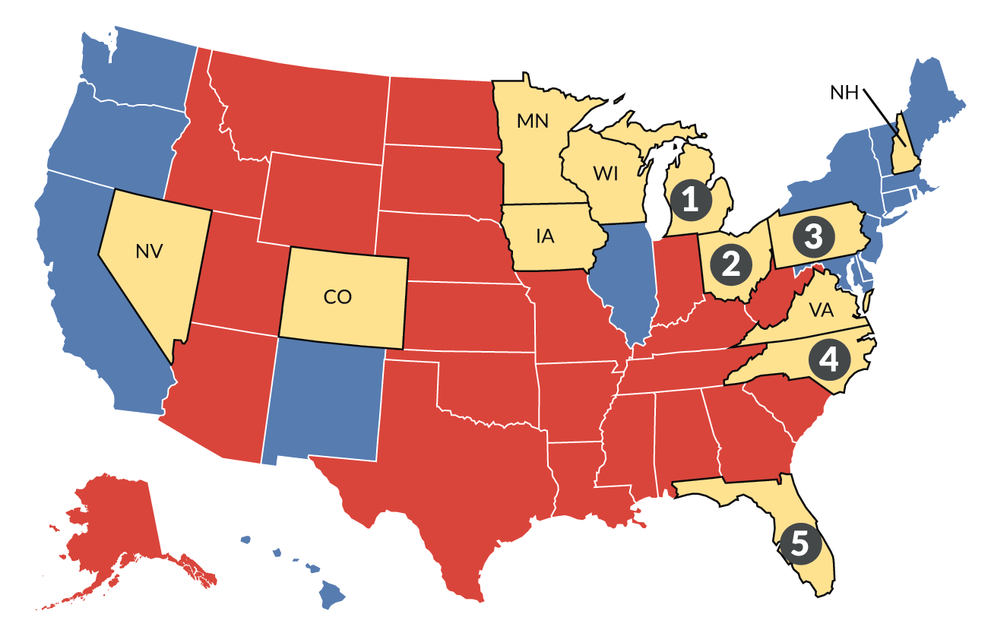
SWING STATES
Democratic Party
Colorado, Virginia, Nevada, New Hampshire, Minnesota, and North Carolina
Republican Party
Florida, Iowa, Michigan, Wisconsin, Ohio and Pennsylvania
Notes:
Madison

Slide 4

GDP
An economic snapshot of a country, used to estimate the size of an economy and growth rate
Affect on a swing state’s economy
Notes:
Madison

Slide 5

Does change in GDP have an effect on election outcomes?
More specifically, does the effect of GDP affect the change in percentage of republican votes (2012-2016) for counties in the twelve swing states.
Notes:
Madison

Slide 6
DATASETS
2015 and 2017 U.S. Census
Presidential Election - CASE01
GDP/Percent Change
CensusID
State, county
Total pop
Gender, race, citizen, income,,
Employment
Unemployment
Transportation
Year, state, county,
FIPS (numeric code for county)
Candidate
Party (Dem/Rep/Ind/etc)
Candidate votes
Total votes
Version (database version)
Real GDP (thousands of chained 2012 dollars)
Percent change from preceding period all of which are distinguished by state and county in rows.
By county 2012-2015
Notes:
Priyanka

Slide 7
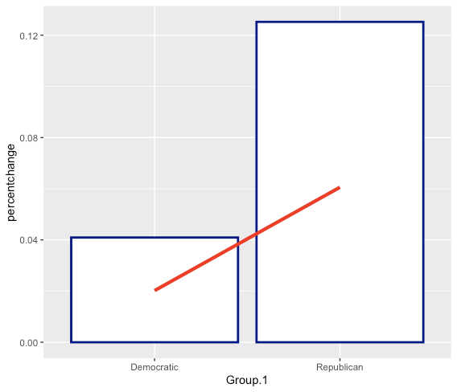
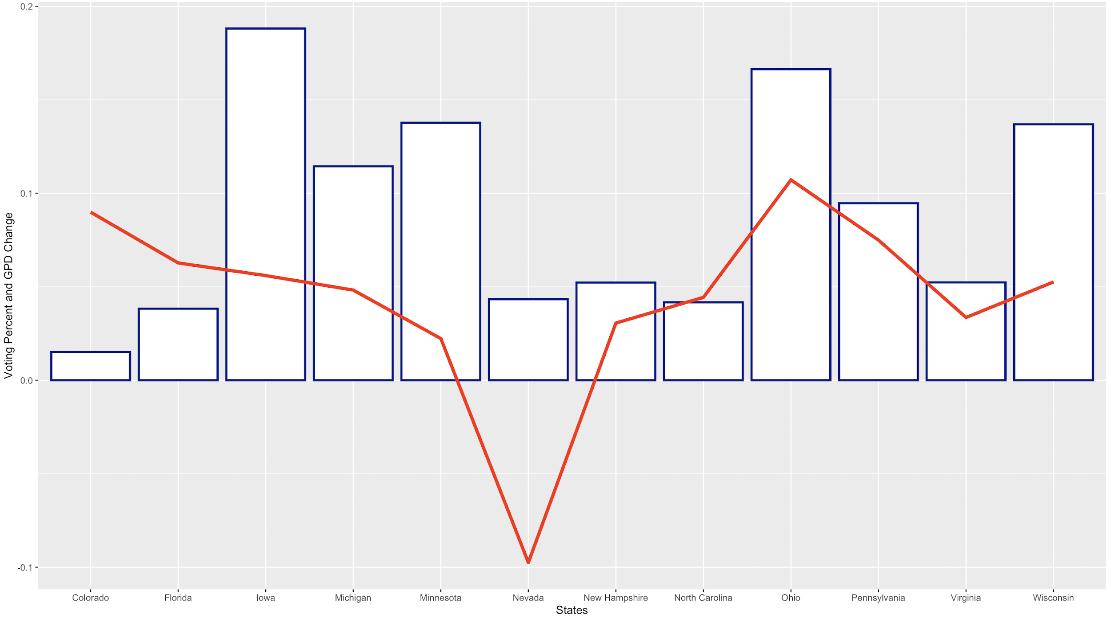
Swing States and Change in Voting Percent and GPD
Notes:
Priyanka

Slide 8
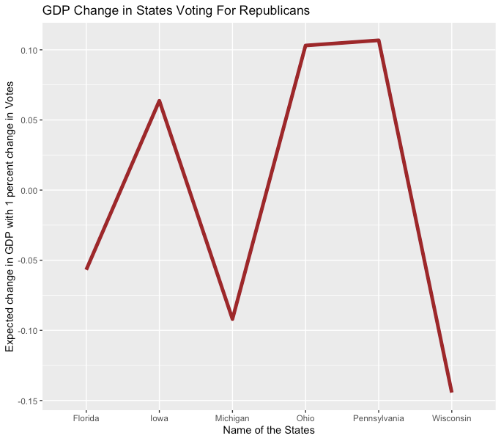
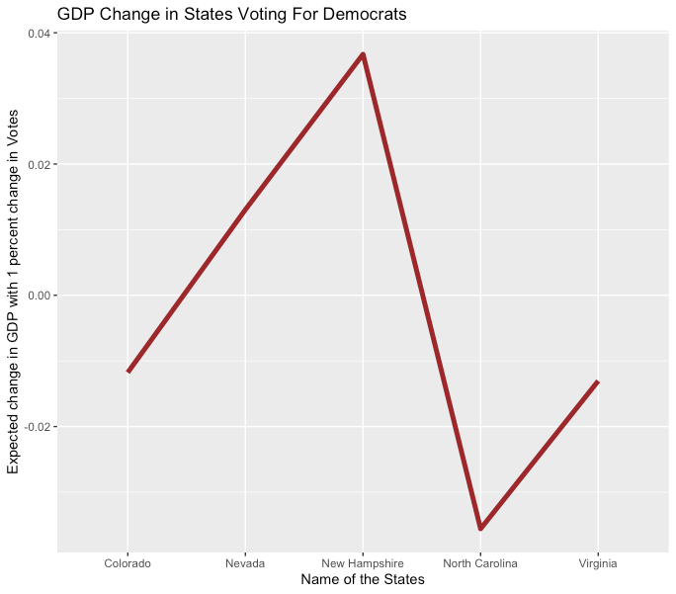
GDP CHANGE IN SWING STATES
Notes:
Priyanka

Slide 9
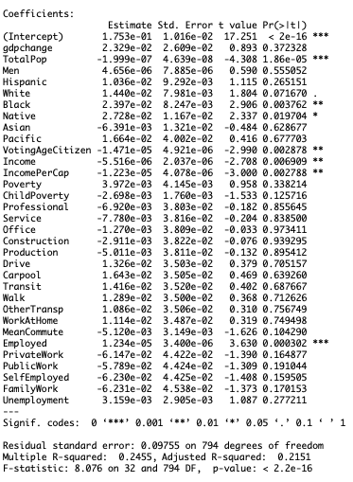

Initial Regression
All swing counties and all variables
How can we clean this up?
Notes:
Ethan

Slide 10
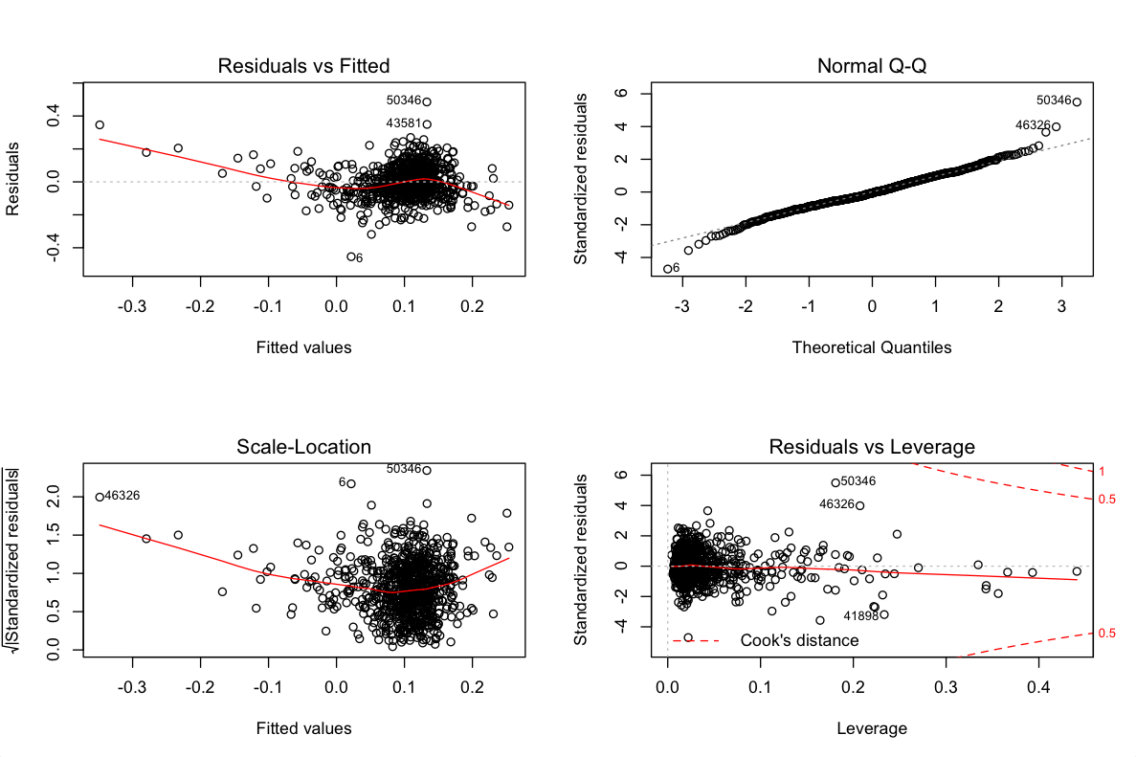
Regression Plots
Notes:
Ethan

Slide 11
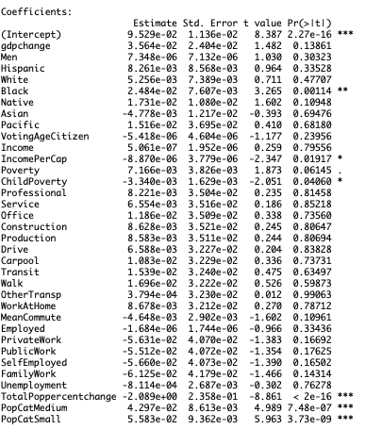
Regression Ideas to Maximize GDP Significance
Change in Total/Democratic Votes
(Higher P - value)
State fixed effects -
GDP P - value (.49)
GDP as a Categorical Variable -
GDP P - Value (>.5)
Population as a Categorical Variable
( regression output to the right )
Initial GDP P - Value (.37)
Notes:
Ethan

Slide 12
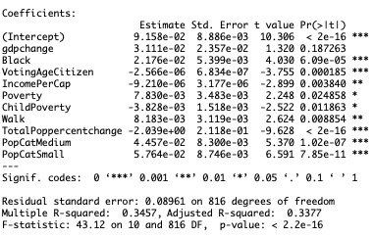
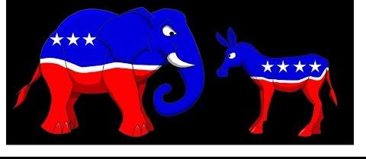
Our “Best” Model
Population as a categorical value
Population change measured in %
Although GDP became less predictive - our other models were too big and less predictive as a whole
Notes:
Ethan

Slide 13
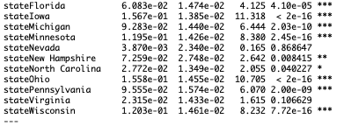
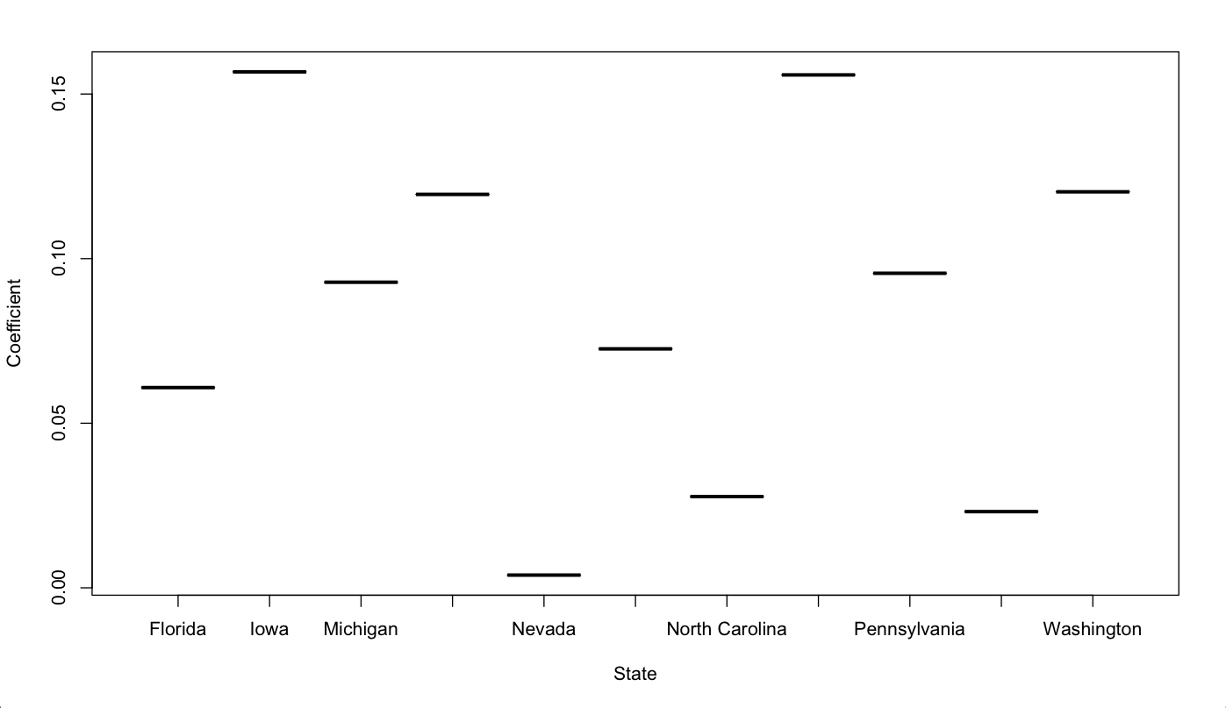
State Effects
Where you live affects how you vote
This negatively affected our regression in terms of GDP significance, but what if we took a look at individual states?
MN
NH
OH
VA
Notes:
Ethan

Slide 14
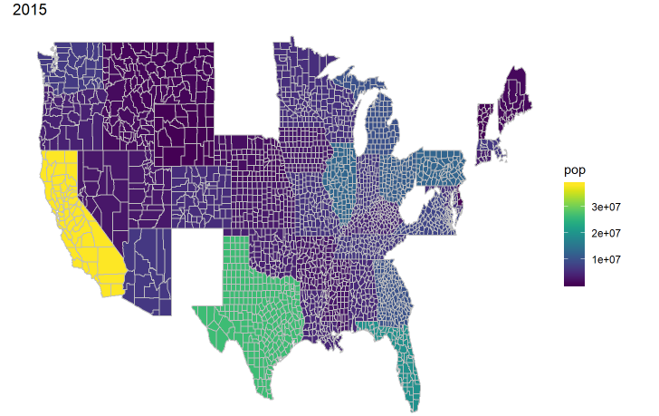
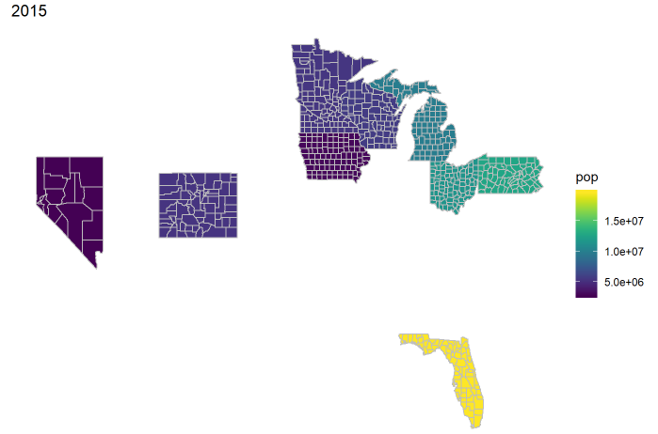
2015
Notes:
Dtree

Slide 15
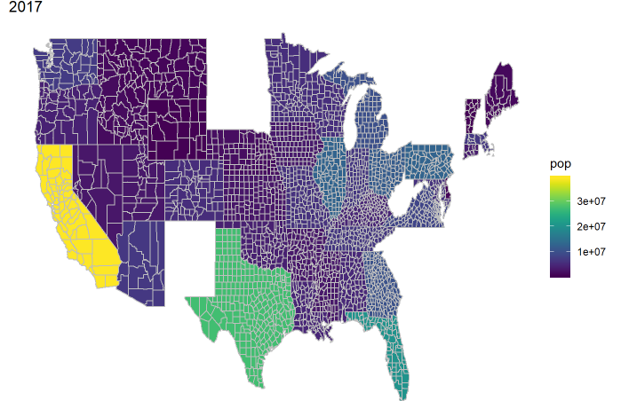
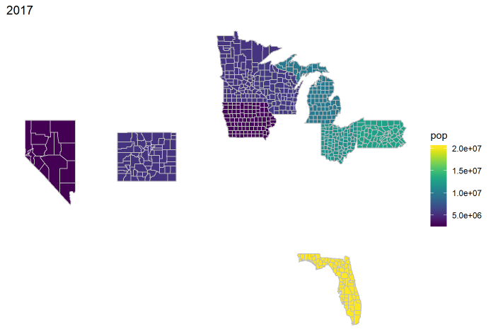
2017
Notes:
Dtree

Slide 16
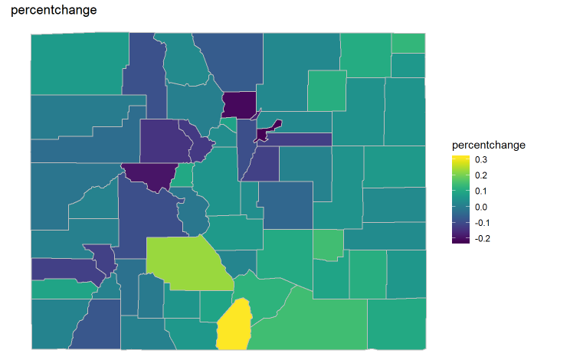
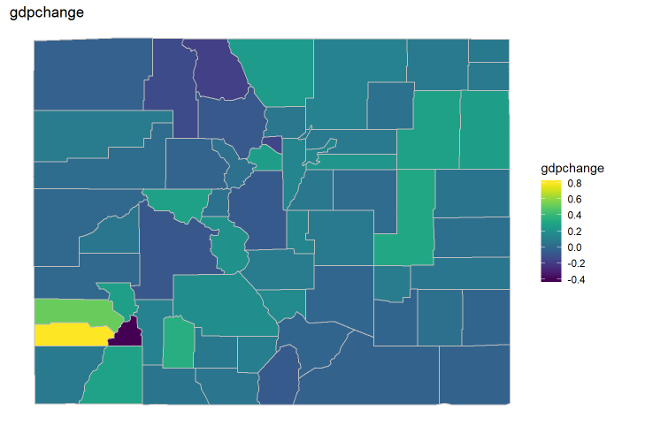
Colorado
Votes changes VS GDP changes
From the below graphics, we can found the correlation is no liner between the vote changes and gdp changes, from the map, the color from light to dark means the percentage from high to low.We found Costilla has the highest percentage of vote changes but the percentage of gdp changes is really small. Dolores has the highest percentage of gdp changes meanwhile the percentage of vote changes is also high. As for Routt, both of votes changes and gdp changes are pretty low, so it's pretty hard to find the linear correlation.
Notes:
Dtree

Slide 17
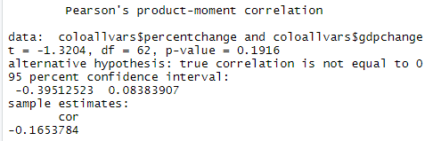
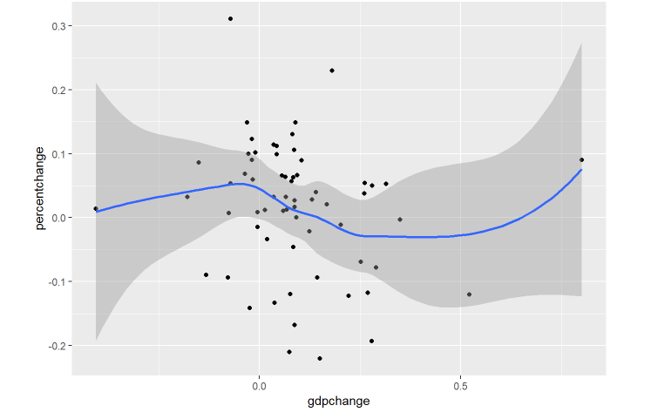
Correlation
Votes changes VS GDP changes
Points are quite diverse
No linear relation
P-value is 0.1916 > 0.05
Value of cor is -0.1653784 which means overall is negative correlation
Increasing when <0
Decreasing when 0-0.5
Increasing when > 0.5, 2 outliers
Notes:
Dtree

Slide 18
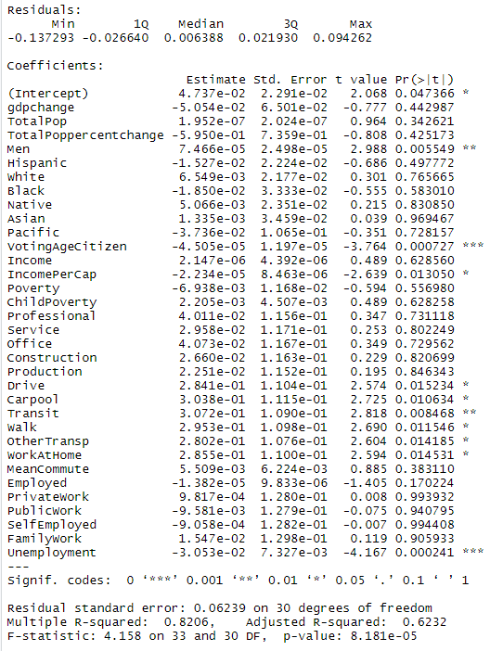
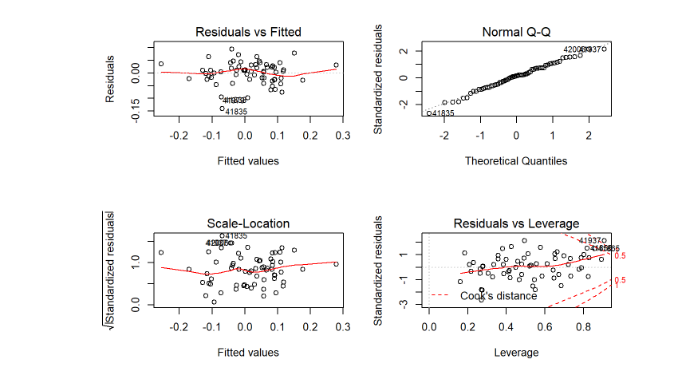
Regression Plots
Notes:
Dtree

Slide 19
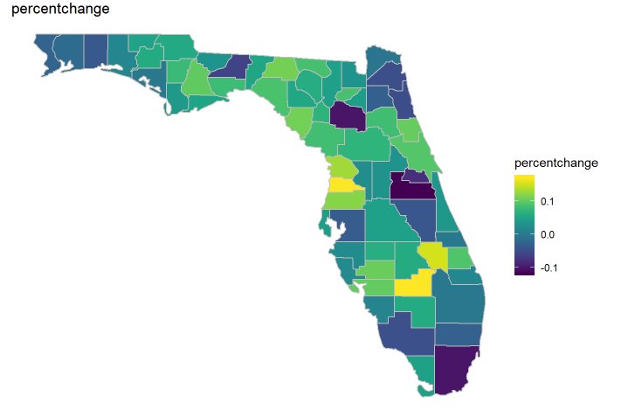
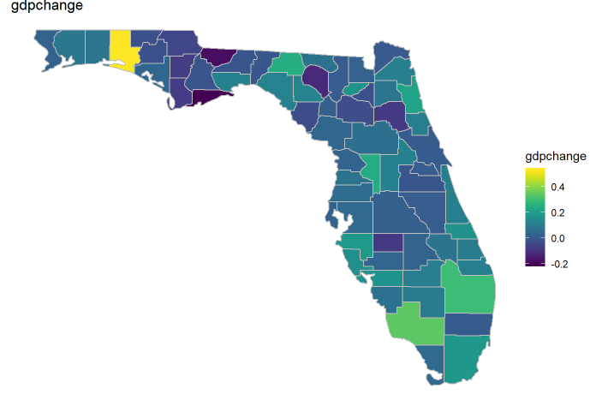
Florida
Votes changes VS GDP changes
Glades: most vote changes, small gdp changes
Walton: most gdp changes, not bad vote changes
Orange: both are pretty low
Notes:
Dtree

Slide 20
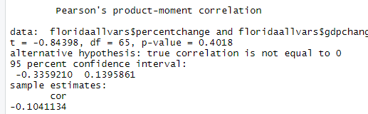
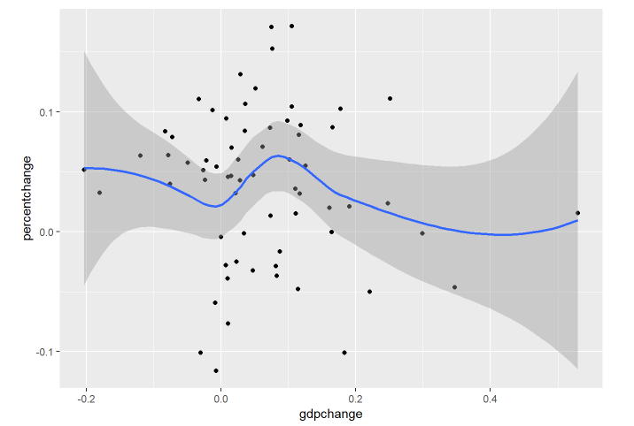
Correlation
Votes changes VS GDP changes
Points are quite diverse
More points because more county
No overall linear relation
P-value is also not good >0.05
Cor is -0.1 means overall negative correlation.
Decreasing when <0
Increasing first then Decreasing when 0-0.4
Increasing when>0.4
Notes:
Dtree

Slide 21
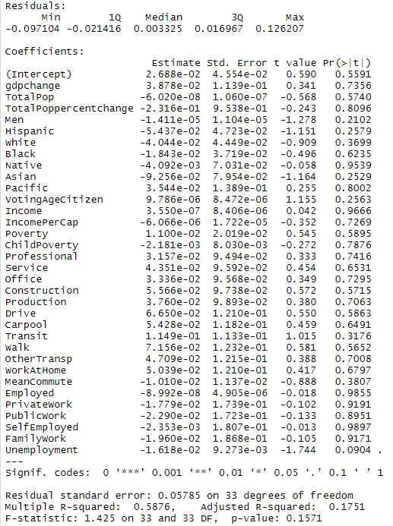
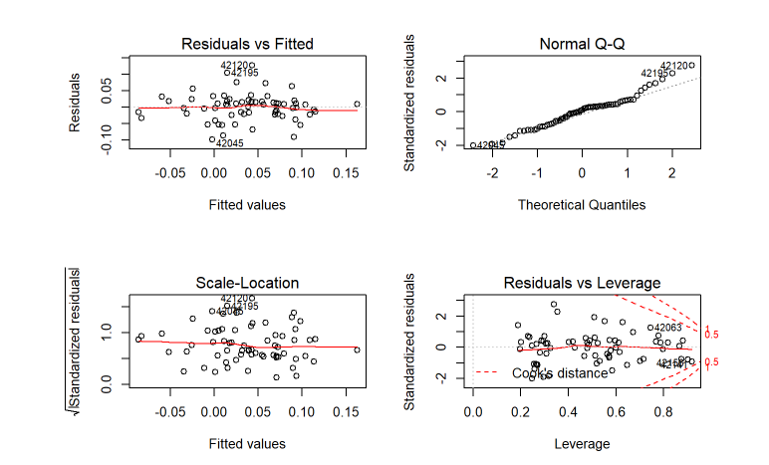
Regression Plots
Notes:
Dtree

Slide 22
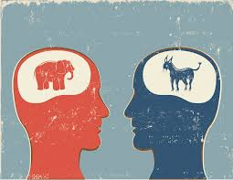
Summary
Analysing different factors that have a significant effect on the election results.
GDP in most of the swing states is not as affected by the change in voting percent.
Demographic predictors proved to have an effect.
Specific factors like size of population, population of black people and the population of the Voting age citizens have significant effect on the change in voting percentage.
The perfect model couldn’t be prepared due to several limitations.
Notes:
Bhanu

Slide 23
Limitations
The data is of only 2016 elections.
Not many factors are present in the data set which could have been trivial to predict the results.
Some factors like Money spent in campaigns, effect of international activities and other local activities can’t be quantifiable.
Notes:
Bhanu

Slide 24
CONCLUSION
Great scope can be seen for this project as it can be used to predict the results of elections.
Due to data limitations, the full extent of analysis wasn’t performed.
Some not quantifiable data effect still needs a proper way to be cleaned and put into use.
These factors make the poll results one of the things that can’t accurately be predicted till date but we have generated an overview of the existing quantifiable factors on the poll results.
Notes:
Bhanu

Slide 25
Thank You

